Slide 1
Midpoint Presentation - Team POBA
Anthony Peters
Shane Pooler
Ryan Stevenson
Kevin White

Slide 2
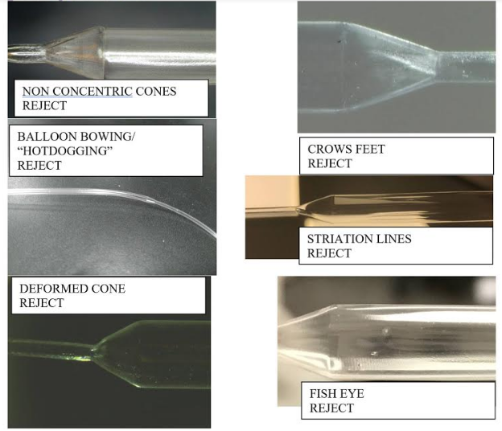
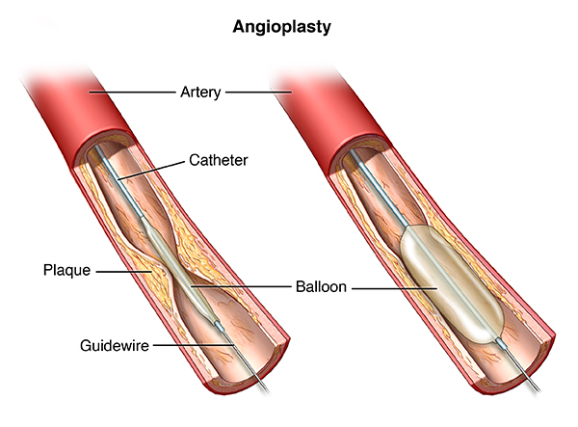
Project Description
Design and manufacture an automated visual balloon inspection device for POBA medical.
Design must be compatible for different balloon sizes and lengths.
Determine dimensions and detect any defects.
Balloon Defects
Pooler
3/15/17
POBA
Slide 2
Catheter Balloon for artery

Slide 3
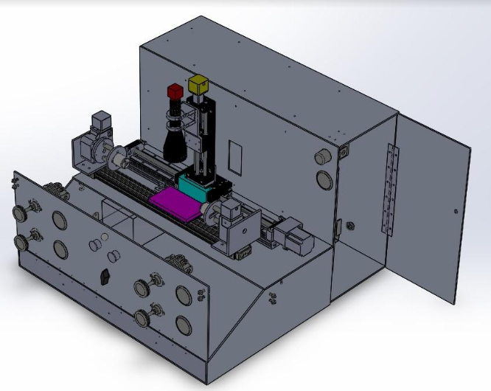
Current Design
Pooler, White
3/15/18
POBA
Slide 3
Current Design

Slide 4
Updates
Current Design has been approved by our client POBA medical
Majority of parts have been ordered such as:
  Linear and Rotary stages
  Air system parts
  Material for frame (Aluminum 6061-T6)
Plan to start building in the coming weeks when parts arrive
White
3/15/18
POBA
Slide 4

Slide 5
Design Changes
Arduino Kit is now being utilized to control motion since previous controller was out of the budget
The size of the frame has been reduced to decrease footprint
Removed rotary union from rotary subsystem to save on cost and simplify design
Changed cameras from Edmund Optics to Cognex
White
3/15/18
POBA
Slide 5

Slide 6
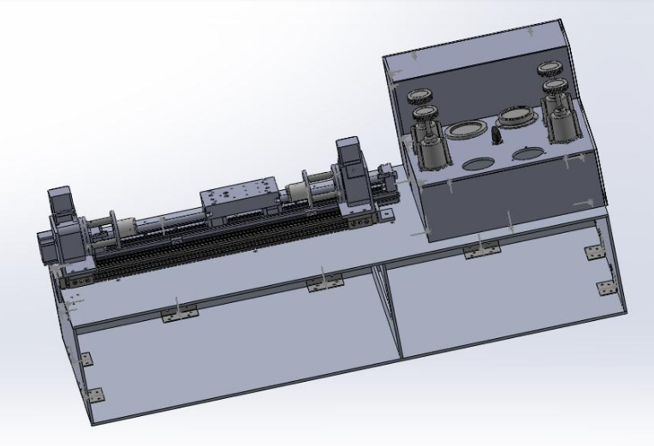
Previous Design vs. Current Design
Previous Design
Current Design
White
3/15/18
POBA
Slide 6

Slide 7
Manufacturing and Testing Plans
Poba has their own manufacturer so we will not be needing to do any manufacturing.
  Frame parts were ordered on wednesday 3/14, we are looking at a lead time of two weeks until we can have the parts ready to install.
As for testing, we will be learning how to utilize the arduino to move the rotary and linear stages. We will also try to get it to take pictures of the balloon and have the pictures stored in a file for viewing
Pooler
3/15/17
POBA
Slide 7

Slide 8
Contingencies
Hole alignment
  For hinge holes the tolerance needed was calculated to be .008 but the machinist that our client uses can only go as low as .015. Therefore, if the holes are slightly off, we will drill out the holes on the hinge to give us more space. The same can be said for the mounting brackets.
Because we already had to redesign the frame, we will not be needing to do that again. But there is a possibility that we will need to drill more holes to accommodate our needs. This does not require a trip to the machine shop, just a power drill.
Pooler
3/15/17
POBA
Slide 8

Slide 9
Original Schedule
Peters
3/15/18
POBA
Slide 9

Slide 10
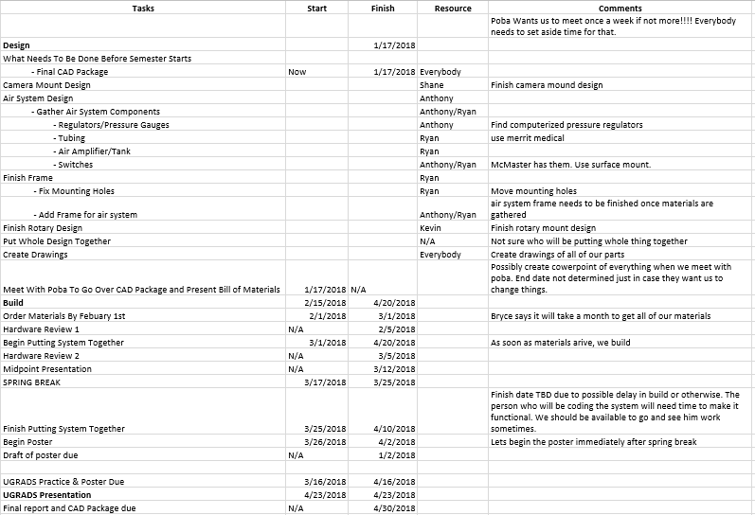
Notes:
We originally wanted to get all of the parts at the beginning of this semester. Giving us plenty of time for the parts to come in, and build the project. We are a little behind schedule since we ordered the parts only a couple weeks ago.

Slide 11
Current Schedule
Peters
3/15/18
POBA
Slide 9

Slide 12
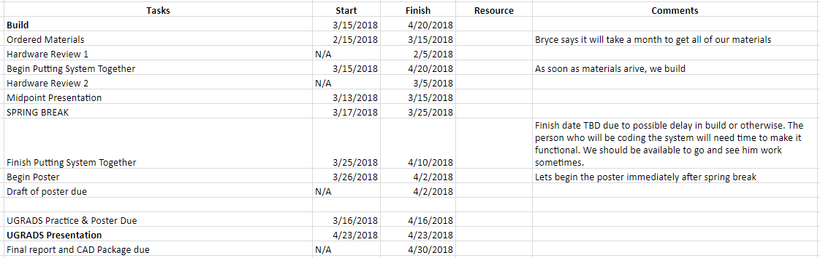
Peters
3/15/18
POBA
Slide 9
Notes:
This is our schedule according the track we are on right now. We got our Newmark products in today which helps us stay on track to build this by our original date.

Slide 13
Schedule and budget changes
Our Schedule had to be pushed back numerous times to accommodate the needs of our clients. They have continuously changed certain components of our design multiple times and all we could do was just try to keep up.
As for our budget, we were told that we were able to use up to $20,000. Since then, our budget has been cut in half. We now have roughly $10,000 - $12,000 to use. Because of this, we had to take out some key components of the design but still leave space for our clients to purchase those parts later on. We have also secured $1000 from NAU to purchase all of our tube fittings and frame fitting components.
Peters
3/15/18
POBA
Slide 11
Notes:
The reason for our schedule changing so much is because of our clients. What they have wanted out of our project has changed significantly since the beginning of this semester. This includes changes to frame design, air system setup, and quality of products. This has made nailing down a final design difficult and time staking to accomplish.
Originally, at the beginning of last semester, we were told we had a budget of about $15,000-$20,000. As this semester has progressed, POBA has realized how expensive quality parts are. This has made them cut our budget dramatically to roughly $10,000-$12,000. We are still getting the frame machined that we have designed. There will just be empty holes where a couple regulators and gauges should be that will be purchased and installed by POBA at a later date. The $1000 given by NAU will be useful in purchasing tube fittings for the air system and fitting components for the frame

Slide 14
What we have purchased so far
Our Clients have already purchased $7,287 worth of parts including 3 air regulators, 3 pressure gauges, and our rotary and linear stages from Newmark Systems. They have also ordered our metal but that amount has not been disclosed yet.
We have $1000 from NAU to use.
There is still roughly $2000 worth of parts for our clients to purchase including brackets and linear track for rotary stages. We will also need to acquire drivers for the motorized stages to attach to the arduino.
This puts our total budget so far around $10,287.
Actual expenses thus far = $7,287 + the cost of the metal and arduino kit.
Peters
3/15/18
POBA
Slide 12
Notes:
As of now, POBA has spent almost $7,300. This includes the big parts of the project such as the rotary and linear stages from Newmark, and the gauges and regulators for the air system. The metal for the frame has been ordered, but is not included in the 7300 since we are unsure of the price for it. On top of all of this, there is still roughly two grand of materials needed to be ordered. This includes the brackets and linear tracks for the rotary stages, and some other small things. Due to budget cuts, we were not able to use a motor from NewMark for the motorized stages. We will instead use an arduino which has already been purchased. To make it work we will need to purchase drivers so the arduino can program the stages. Barring any other changes to our design, our projected overall budget comes out to around $10.5k.

Slide 15
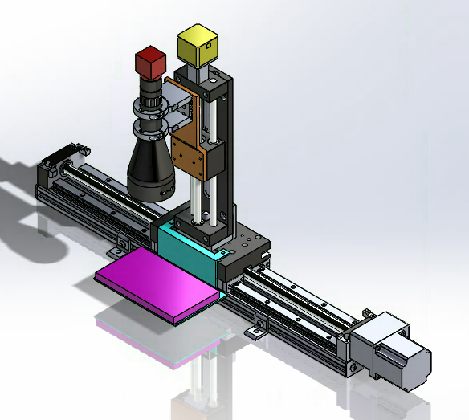
Vision System
Includes Cognex camera (red), 0.16x telecentric lens (black), adaptor plate (orange), linear stage adaptor plate (teal), and backlight (purple).
Camera, lens, and backlight all move in unison along length of the linear stage.
Z-stage allows for coarse adjustment.
Full Vision System Assembly.
Pooler
3/15/17
POBA
Slide 13

Slide 16
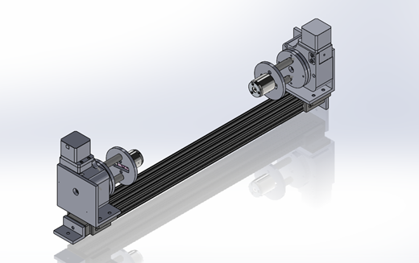
Rotary System
Two RM-3 Rotary Stages used to rotate catheter balloon
Two CCB Pneumatic Tube Grabbers to hold catheter balloon in place
Custom 3D printed mounts to hold design together
Rotary system is mounted on 29 inch t-slotted slide in order to hold all balloon sizes
White
3/15/18
POBA
Slide 14
Full Rotary Assembly

Slide 17
Air System
Original Design
POBA asked for there to be a high and low pressure side of the air system, with each having a nominal and burst portions
  The low and high pressure sides are so POBA can test all of the balloons they make no matter the size of them
  The nominal pressure is for testing the balloons at what they will be used at while the burst pressure is used to see if it can handle the highest pressure it will encounter
In total this comes out to four different pressures, with each pressure needing a regulator to get to and a gauge to ensure the regulator is giving the balloon the correct psi
Peters
3/15/18
POBA
Slide 15
Notes:
The air system we had designed at the beginning of this semester was very complex. There was a high and low pressure side, with both having a nominal and burst pressure setting. This setup gives POBA four different pressure settings to test their balloons. In testing, a balloon will only use two of them though, the nominal and burst. The nominal setting tests the balloon at the pressure it will typically be used at. The burst setting tests to ensure that is safe for a large range of pressures. Even though it probably won't ever be used at the burst pressure.

Slide 18
Air System
Original Design
regulator
solenoid
Burst
gauge
High
Buttons for bladder
Tank
Burst
Balloon
air amplifier
Nominal
Nominal
tank
Low
actuated control valve
Peters
3/15/18
POBA
Slide 15

Slide 19
Air System
Current Design
Due to budget cuts we have had to make a couple changes
  There will be no burst pressure on either side of the air system
  Different gauges will be used
    POBA decided on a cheaper option that is about 1% less accurate than the original
  The solenoid valve will not be used
  A tank will no longer be needed since air amplifiers are no longer necessary
    Air amplifiers are not necessary because the high pressure side of the system will be using a smaller psi than we originally planned for
Peters
3/15/18
POBA
Slide 15

Slide 20
Air System
Current Design
regulator
High
gauge
Balloon
Buttons for bladder
Tank
Low
Peters
3/15/18
POBA
Slide 15

Slide 21
What’s Next
Start building design once all parts arrive
Incorporate arduino into design
Start testing design
White
3/15/18
POBA
Slide 16

